Slide 1
Heart Disease Classification
Implications for Personalized Treatment Strategies
Sani Prajapati
03-03-2024

Slide 2
Outline
Reference
Introduction
Data Overview
Understanding Heart Disease:
Machine Learning in Healthcare:
Data Exploration and Preprocessing:
Exploratory Data Analysis
Machine Learning Models for Heart Disease Prediction:
Model Evaluation
Conclusion:

Slide 3
Reference
Dataset Title: Heart Disease dataset
Platform: Kaggle
URL: https://www.kaggle.com/heart-disease-dataset

Slide 4
Introduction
Definition of Heart Disease
Importance of Early Prediction
Overview of Machine Learning in Healthcare

Slide 5
Definition of Heart disease
Heart disease, or cardiovascular disease (CVD), encompasses a diverse array of conditions that affect the heart's structure and function, ranging from coronary artery disease to arrhythmias.
Atherosclerosis, the insidious narrowing of blood vessels, often serves as the culprit, leading to compromised blood flow and manifesting symptoms like chest pain and irregular heartbeat.
Globally, heart disease holds a grim position as one of the leading causes of mortality, stressing the critical need for proactive preventive measures.

Slide 6
Importance of Early Prediction
Early prediction allows for prompt intervention and treatment, which can significantly reduce the progression of heart disease and prevent complications.
Early prediction and intervention can help mitigate the need for costly medical procedures and hospitalizations associated with advanced stages of heart
Early detection allows individuals to make lifestyle changes and adopt healthier habits, thereby improving their overall quality of life and minimizing the impact of heart disease on daily activities and well-being.

Slide 7
Propose Of The Presentation
The presentation aims to underscore the critical significance of early prediction in addressing heart disease, highlighting its role in mitigating complications and improving patient outcomes.
Through compelling insights and evidence, the presentation endeavors to raise awareness about the global burden of heart disease and the urgency of preventive measures, fostering a sense of urgency among healthcare professionals and the general public.
Ultimately, the presentation aims to inspire action by encouraging healthcare providers to integrate early prediction strategies into their practice and motivating individuals to prioritize heart health through lifestyle modifications and regular screenings

Slide 8
Data Overview
age
sex
cp = chest pain type (4 values)
trestbps = resting blood pressure
chol = serum cholestoral in mg/dl
fbs = fasting blood sugar > 120 mg/dl
restecg = resting electrocardiographic results (values 0,1,2)
thalach = maximum heart rate achieved
exang = exercise induced angina
oldpeak = ST depression induced by exercise relative to rest
slope = the slope of the peak exercise ST segment
ca = number of major vessels (0-3) colored by flourosopy
thal: 3 = normal; 6 = fixed defect; 7 = reversable defect
target:0 for no presence of heart disease, 1 for presence of heart disease

Slide 9
Understanding Heart Disease
Heart disease, encompassing conditions like coronary artery disease and heart failure, is a pervasive health concern worldwide.
Risk factors such as high blood pressure, cholesterol, and smoking contribute to its development, leading to complications like chest pain and irregular heartbeats.
With its profound impact on morbidity and mortality rates, comprehending heart disease is crucial for implementing effective preventive measures and optimizing patient care.

Slide 10
Machine Learning In Healthcare
Machine learning applications in healthcare harness the power of data analysis to optimize disease diagnosis, treatment planning, and patient management.
By leveraging algorithms to interpret complex medical data, machine learning enhances medical imaging interpretation, facilitates predictive analytics, and enables personalized medicine approaches.
These advancements contribute to more accurate diagnoses, timely interventions, and improved healthcare outcomes, ultimately revolutionizing the delivery of healthcare services.

Slide 11
Data Exploration and Preprocessing:
About Dataset
Descriptive Statistics

Slide 12
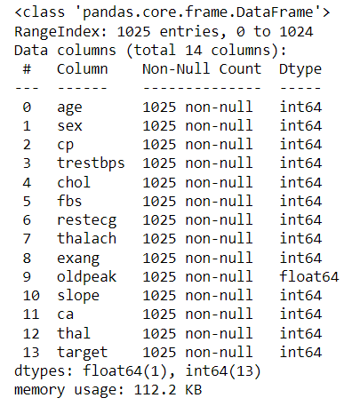
About Dataset
1.The Dataset consists of 1025 entries (rows) and 14 columns, with each column representing a different feature related to heart health.
2.All columns have non-null counts equal to the total number of entries, indicating that there are no missing values in the dataset.

Slide 13
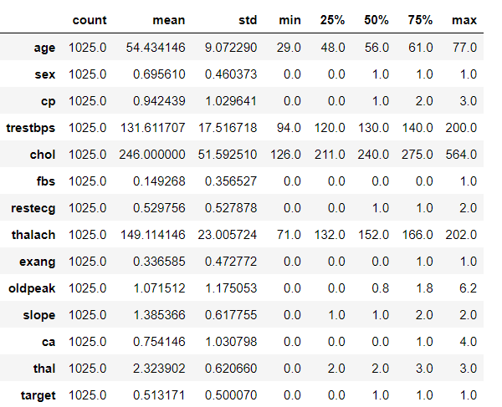
Descriptive Statistics
Age: Mean 54.43 ± 9.07 years, range 29-77 years.
Sex: Majority male (69.56%).
Chest Pain: Mean 0.94 ± 1.03, likely 'typical angina' (value 0).
Resting Blood Pressure: Mean 131.61 ± 17.52 mm Hg, range 94-200 mm Hg.
Serum Cholesterol: Mean 246 ± 51.59 mg/dl, range 126-564 mg/dl.
Fasting Blood Sugar: 14.93% > 120 mg/dl.
Resting ECG: Mean 0.53, mixed normal and abnormal results.
Max Heart Rate: Mean 149.11 ± 23.01 bpm, range 71-202 bpm.
Exercise-Induced Angina: 33.66% positive.
ST Depression: Mean 1.07 ± 1.18 mm, range 0-6.2 mm.
ST Segment Slope: Mean 1.39, mostly upsloping or flat.
Major Vessels Colored: Mean 0.75 ± 1.03.
Thalassemia: Mean 2.32, mixed 'normal', 'fixed defect', and 'reversible defect'.
Heart Disease: 51.32% diagnosed.

Slide 14
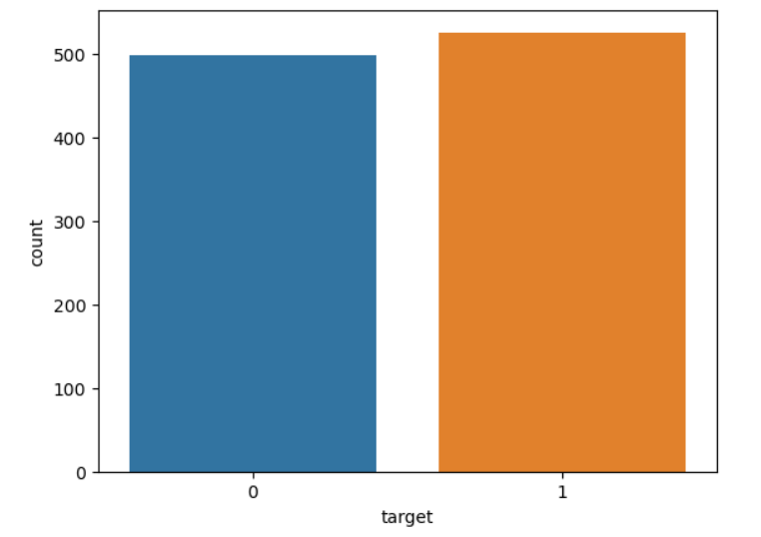
EDA
1.The target column distribution highlights 526 instances labeled as 1 (positive outcome) and 499 instances labeled as 0 (negative outcome).
2.This provides a snapshot of the distribution, showcasing the number of occurrences for each target class in our dataset.
3.There is a subtle imbalance observed, with a slightly higher count in the positive outcome (1) compared to the negative outcome (0).
4.Recognizing this imbalance prompts us to consider tailored strategies during model development to ensure fair representation and accurate predictions for both classes.

Slide 15
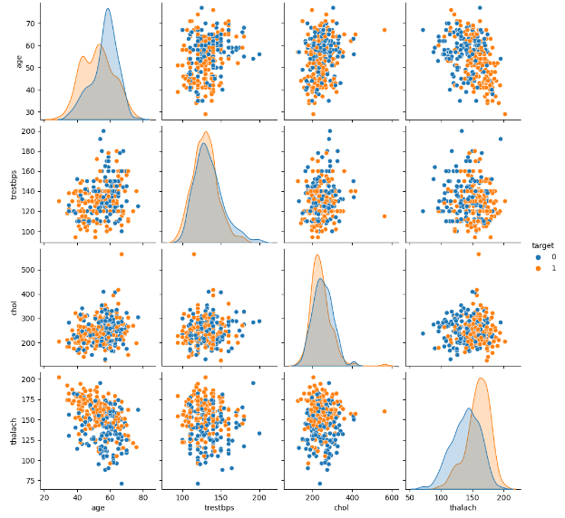
Pair plot
1.The pairplot analysis, with age, blood pressure (trestbps), cholesterol (chol), and maximum heart rate (thalach), reveals intriguing patterns differentiating between the two target classes. Notably, there appears to be a nuanced relationship between age and thalach, showcasing potential distinctions in cardiovascular health.
2.The scatter plots for trestbps and chol highlight diverse clusters, offering insights into the complex interplay between these vital indicators. Overall, this visualization underscores the importance of these features in distinguishing between individuals with positive and negative target outcomes.

Slide 16
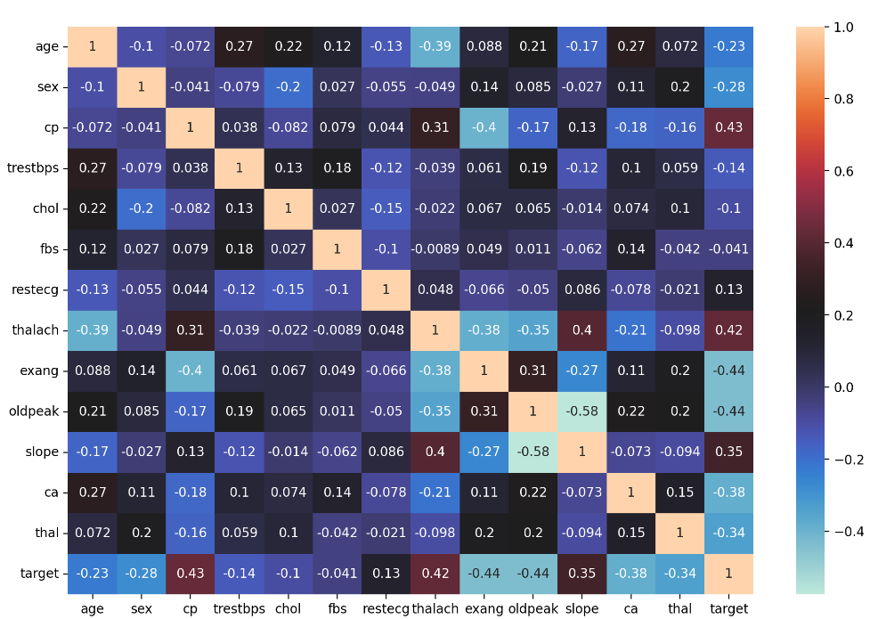
Correlation
Strong Positive Correlations:
1.The heatmap reveals significant positive correlations between the target variable and features such as 'cp' (chest pain), 'thalach' (maximum heart rate achieved), and 'slope' (slope of the peak exercise ST segment).
2.These strong positive associations suggest that as these features increase, the likelihood of the positive outcome in the target variable also increases.
Negative Correlations:
1.Notable negative correlations are observed with features like 'exang' (exercise-induced angina) and 'oldpeak' (ST depression induced by exercise relative to rest).
2.This indicates an inverse relationship, suggesting that higher values in these features are associated with a decreased likelihood of the positive outcome in the target variable.

Slide 17
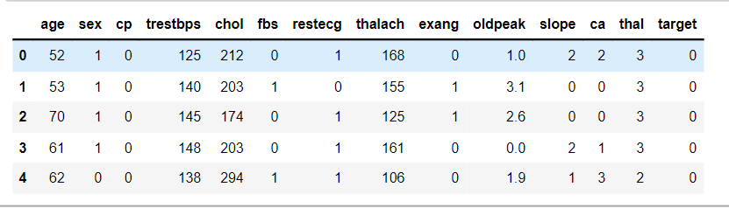
Feature Scaling
1.Feature scaling is a data preprocessing technique used in machine learning to standardize or normalize the range of independent variables or features in a dataset.
2.It ensures that all features contribute equally to the model's performance by bringing them to a similar scale. Common methods include normalization (scaling features to a range between 0 and 1) and standardization (scaling features to have a mean of 0 and a standard deviation of 1)
3.Feature scaling helps improve the convergence speed of optimization algorithms and enhances the overall stability and performance of machine learning models

Slide 18
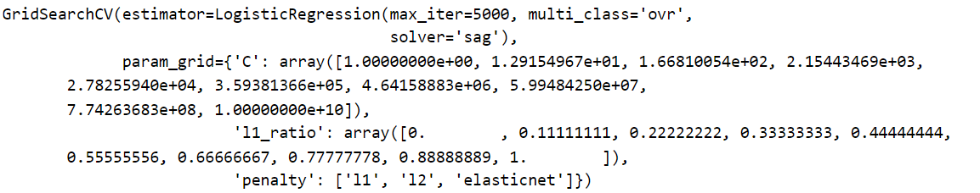
Hyperparameter Tunning
1.The 'C' parameter grid contains an array of values ranging from 1 to 10^10.
2.The 'l1_ratio' parameter grid contains an array of values ranging from 0 to 1, representing the elastic net mixing parameter.
3.The 'penalty' parameter grid specifies the regularization penalties to be tested: 'l1', 'l2', and 'elasticnet'.

Slide 19
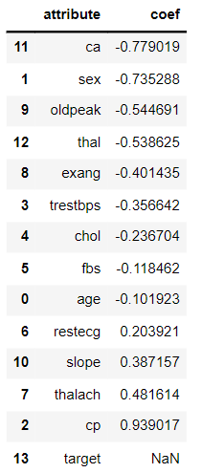
Coefficient
This table represents the coefficients obtained from a trained logistic regression model. Each coefficient indicates the strength and direction of the relationship between a specific feature and the target variable.
1.Negative Coefficients: Features with negative coefficients, such as 'ca', 'sex', and 'oldpeak', have a negative impact on the target variable. As these features increase, the likelihood of the target variable decreases.
2.Positive Coefficients: Conversely, features with positive coefficients, such as 'thalach', 'cp', and 'slope', have a positive impact on the target variable. An increase in these features corresponds to an increase in the likelihood of the target variable.
2.NaN Coefficient: The 'target' feature has a NaN coefficient, indicating that it is the target variable itself and is not included in the coefficients calculated by the logistic regression model. This is because the target variable is the variable of interest that the model aims to predict, rather than being a predictor of other variables.

Slide 20
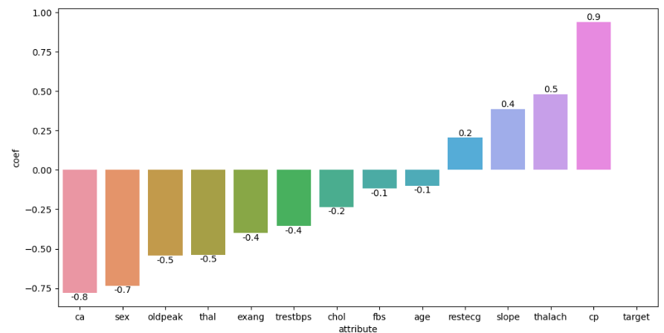
Coefficient Visualization
Conversely, features with positive coefficients, such as 'thalach', 'cp', and 'slope', have a positive impact on the target variable. An increase in these features corresponds to an increase in the likelihood of the target variable.
Features with negative coefficients, such as 'ca', 'sex', and 'oldpeak', have a negative impact on the target variable. As these features increase, the likelihood of the target variable decreases.

Slide 21
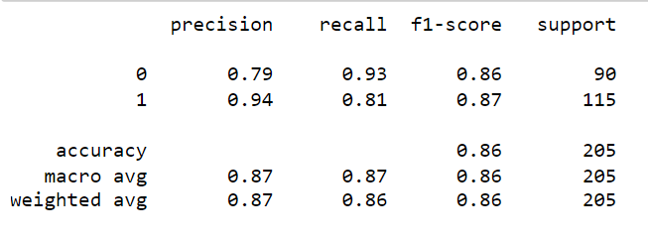
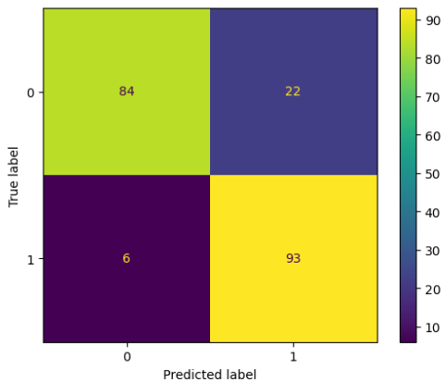
Model Evaluation
1.The model achieves a precision of 0.79 for class 0 and 0.94 for class 1. This indicates that among the predicted positive cases, 79% of them are truly positive for class 0, and 94% are truly positive for class 1.
2.The recall, also known as sensitivity, is 0.93 for class 0 and 0.81 for class 1. This means that the model correctly identifies 93% of all actual positive instances for class 0 and 81% for class 1.
3.The F1-score, a harmonic mean of precision and recall, is 0.86 for both classes. It balances precision and recall, providing a single metric to evaluate the model's overall performance.
4.Support refers to the number of actual occurrences of each class in the dataset. Class 0 has 90 instances, and class 1 has 115 instances.
5.The overall accuracy of the model is 86%, indicating the proportion of correctly classified instances out of the total instances.

Slide 22
Conclusion
In conclusion, the journey towards effective heart disease prediction is paramount for ensuring better health outcomes and reducing mortality rates globally. By harnessing the power of machine learning and data analytics, we can unlock valuable insights from patient data to identify early signs and risk factors associated with heart disease.
Through collaborative efforts between healthcare professionals, researchers, policymakers, and communities, we can drive initiatives focused on raising awareness, promoting healthy lifestyles, and advocating for regular screenings. These efforts empower individuals to take proactive steps towards heart health and enable healthcare systems to allocate resources more efficiently.
As we continue to innovate and advance predictive modeling techniques, let us remain committed to the cause of early detection and prevention of heart disease. Together, we can make significant strides in improving the quality of life for individuals affected by cardiovascular conditions and building a healthier future for generations to come.

